Slide 1
Training Guide
November, 2021

Slide 2
Why offer Zip Business?
Increase average order size
2. Get paid upfront, while offering longer terms
3. Potential tool to earn more incentives
Universal trade account
Give customers better access to cash flow leading to increased orders
Give customers a further 4 months to pay.
Sell more, more often!
4. Increase sales conversion rate
5. Stop chasing customers for payment
6. Once off easy application
Interest free &
flexible terms
Unique offers
Stand out from your competitors with best-in-class payment terms.
Do what you’re good at, provide simply the best quality concrete and service. .
Improve experience with seamless onboarding for new customer.

Slide 3
Zip Business Products
Additional cash flow
For managing projects
Up to $3K
Up to $150K
Reusable credit limit
Reusable credit limit
Fast approvals
No Paperwork
Ideal for your small purchase items
Best choice for your everyday purchases
Interest free forever
Up to 60 days fee free or extend for another 4 months for a fixed fee
No Interest
Or fees if have zero balance
Minimum repayment of $200 per month, $20 per month account fee (waived if no balance).
Flexible repayment schedule, pay it anytime
Flexible repayments
giving longer term to pay

Slide 4
Zip Business Repayment Schedule
Jan
$4,000
transaction
Zip Pays
Merchant
Customer has up to 60 days fee free
No interest ever
Flexible repayments to suit business needs without interest
No repayments for up to 60 days
Pay later, for business expenses
Extend for longer terms
With Zip Business Trade Plus customers can have a total of 5 months to repay
With Zip Business Trade customers can extend for 1.5 yrs paying the minimum
January transactions are due at end of Feb.
Pay in full for no fees
OR;
Feb
Mar
Apr
May
Split over 4 instalments,
3% extension fee
$1,000 payment
+$30 extension fee
$1,000 payment
+$30 extension fee
$1,000 payment
+$30 extension fee
$1,000 payment
+$30 extension fee
Pay $200 min payment & $12 monthly account fee if balance owing
$200 payment
$12 Account Fee
$200 payment
$12 Account Fee
$200 payment
$12 Account Fee
$200 payment
$12 Account Fee
Continued until balance repaid

Slide 5
Customers on COD
Provide longer payment terms, while getting paid upfront.
When
to offer
Zip Business
Customers with frozen accounts
Allow them to get the stock they need today, pay later.
Overdue accounts/Need more time to pay
Assist in collecting overdue funds by giving flexible repayment options (current invoice)
New customers /application for credit account
Offer faster paperless sign-up. Approval within 2 hrs and no admin. Get longer terms.
Customers with accounts
Extend their existing terms with more funds to manage stocks in peak season
Notes:
LD: we need to spell out the actual 12 countries so put name of country in small text next to flag and show when we add 2021 we get to 25 or whatever number is Also we need to be clear on what we say here. Integrate once into API and instantly ofer in all markets Where do we talk about the fact we go into any market (and will go into others for you) get the licences, treasury, finance, risk and solve this for you

Slide 6
Merchant Journey

Slide 7
How to introduce Zip!
“We have partnered with Zip Business to provide you with longer payment terms. Their Trade Plus product allows you repayment and fee free up to 60 days and it’s always interest free when getting stock from us. If it sounds interesting, I can send you a link to find out more and apply”
3 steps….
Introduce - Mention early & mention often
Highlight key benefits
Send the link (landing page or Website - (https://zip.co/au/business/trade#product-towers)
Highlight
No repayment for up to 60 days
Ability to extend further with a 3% fixed fees (Trade Plus)
Once off set up and reuse

Slide 8
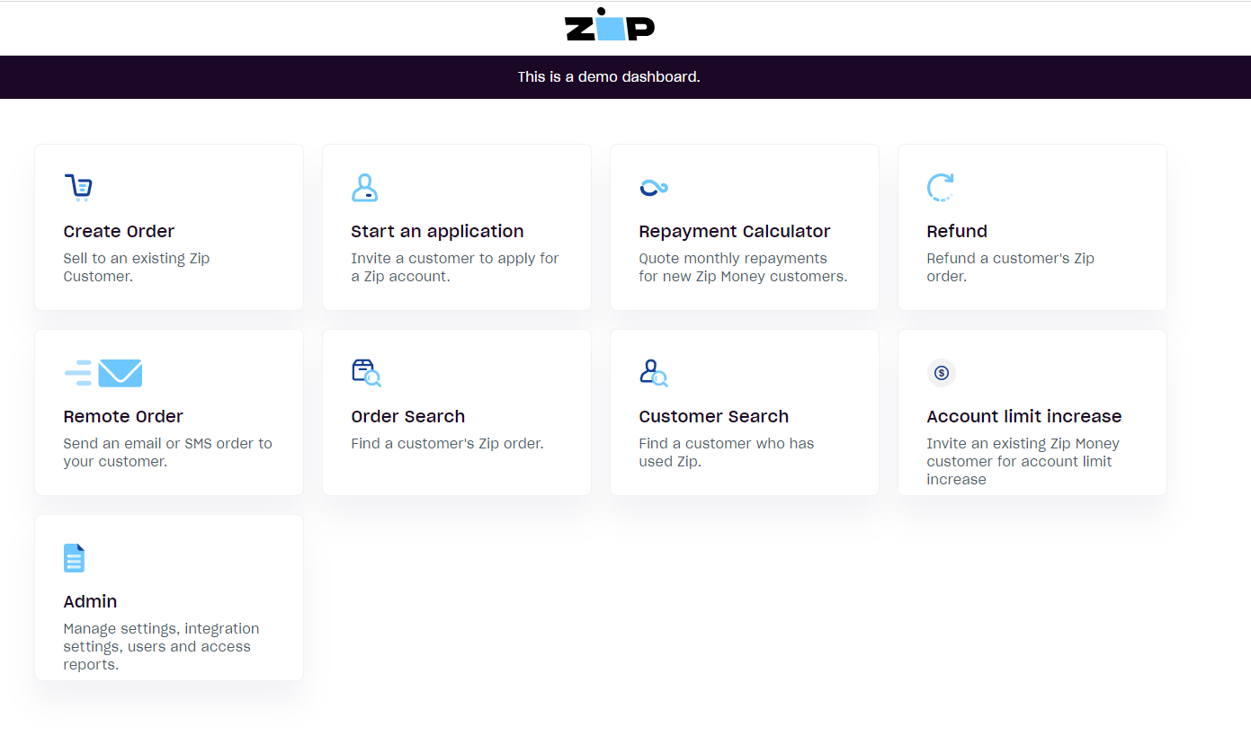
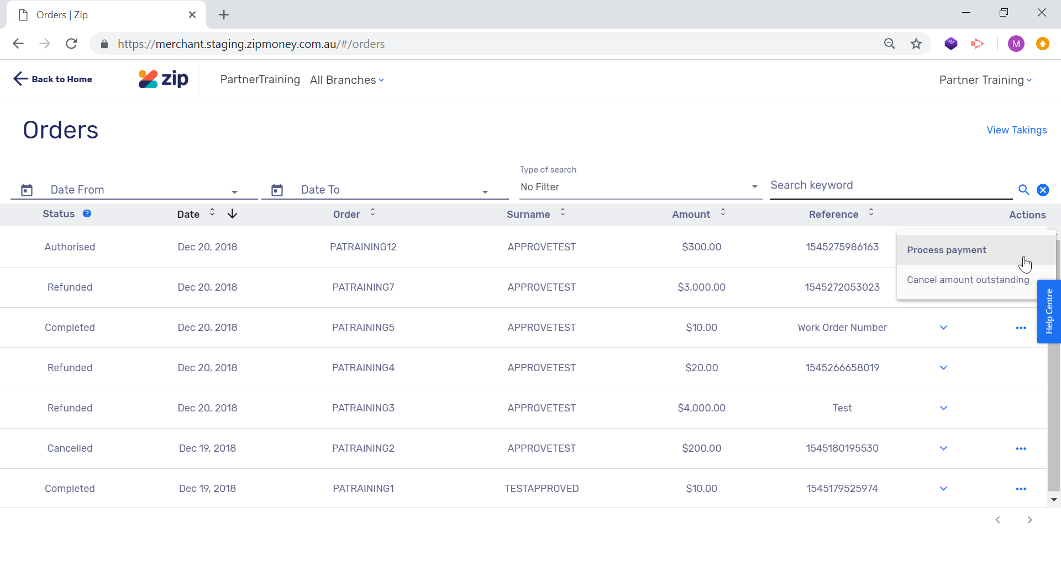
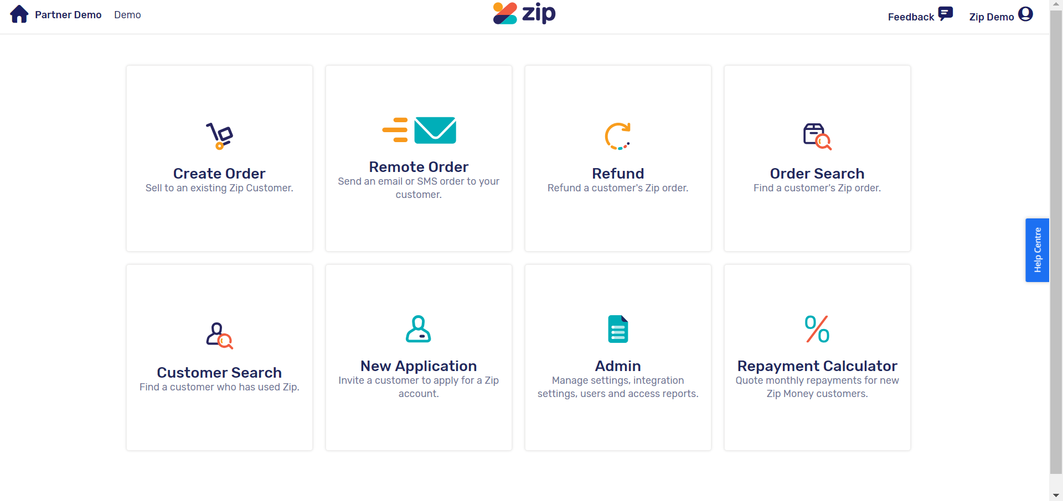
The Zip Dashboard
All Zip transactions occur via your Zip Dashboard.
The Dashboard can be accessed via zip.co/merchant and works on a desktop and tablet.
Once logged in, the home screen will appear where you can select options from the listed tiles.

Slide 9
Create Order
From the Zip Dashboard select the Create Order Tile.
Your customer will then be required to sign into their Zip account to accept the order.
The following page will demonstrate the customer side of processing a Zip transaction.

Slide 10
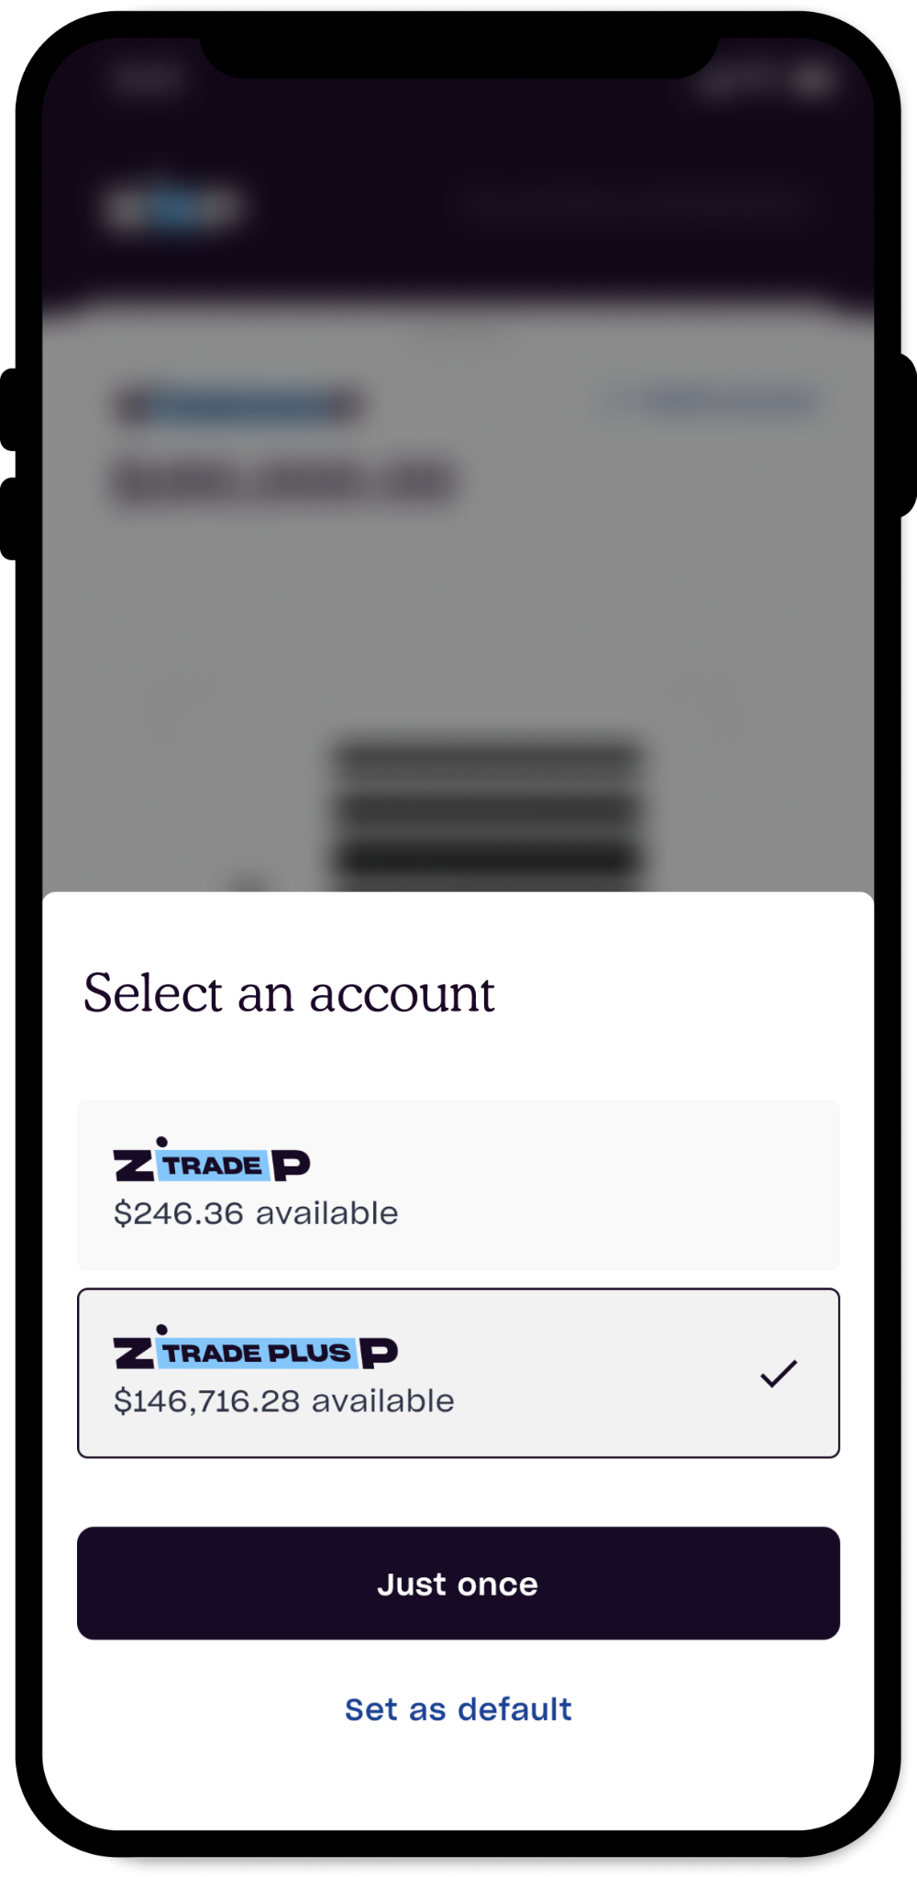
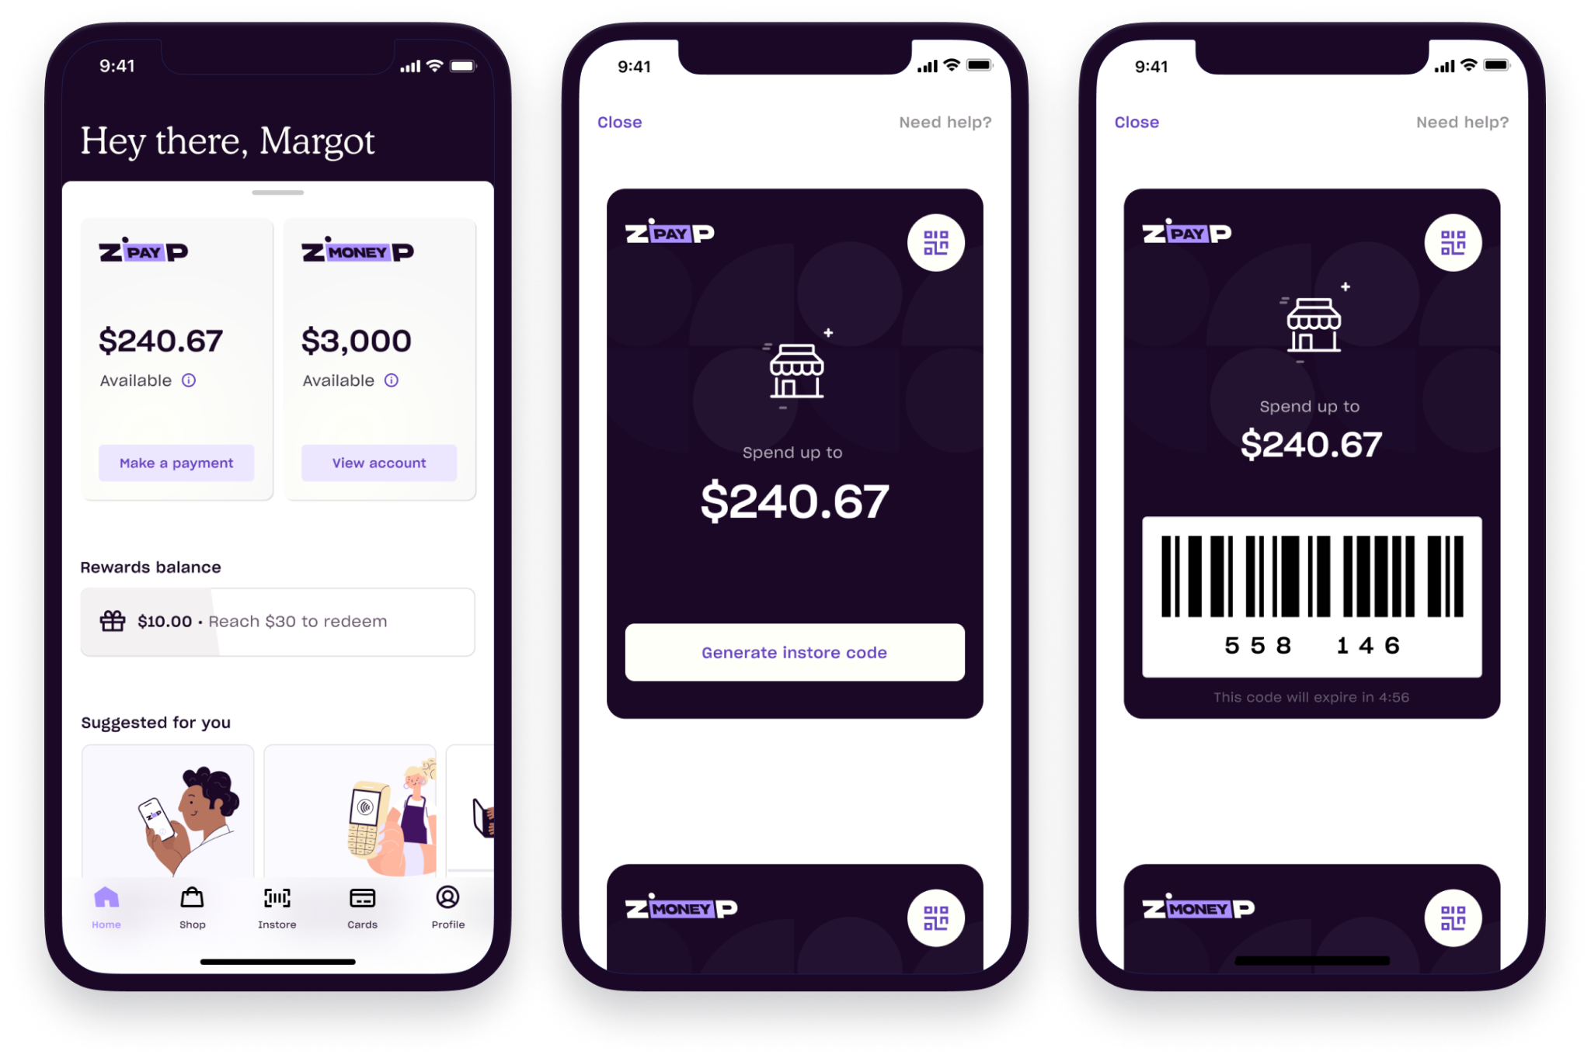
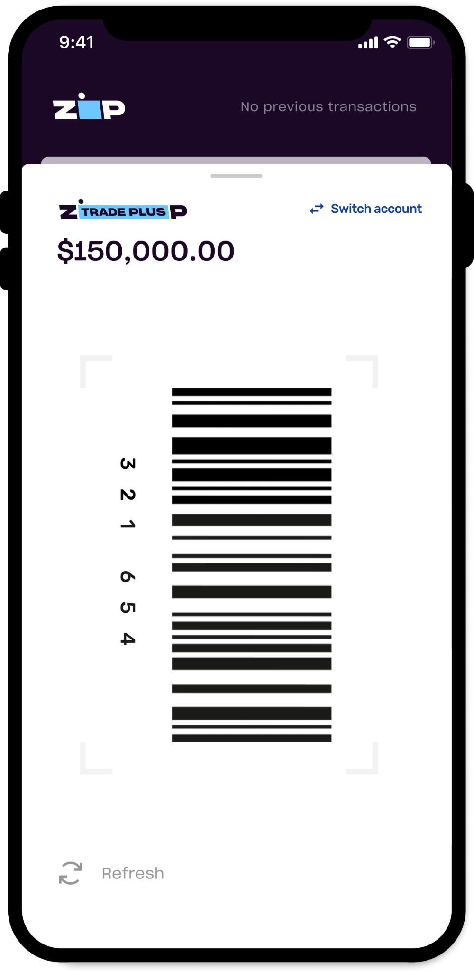
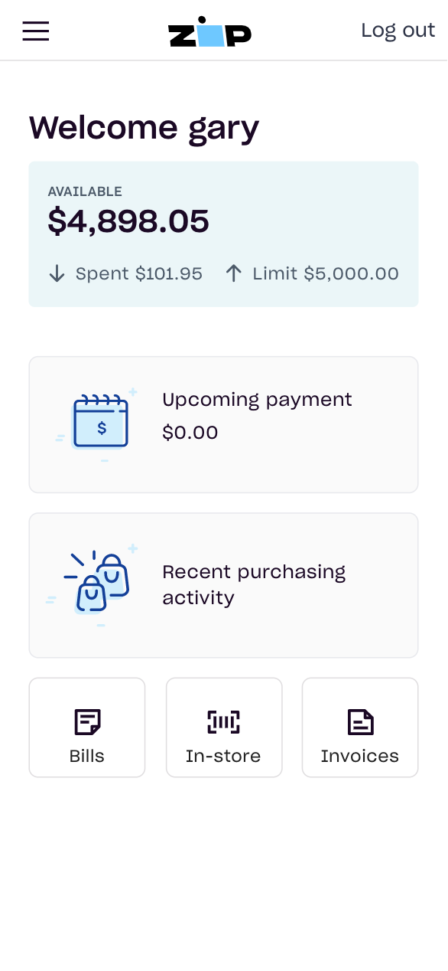
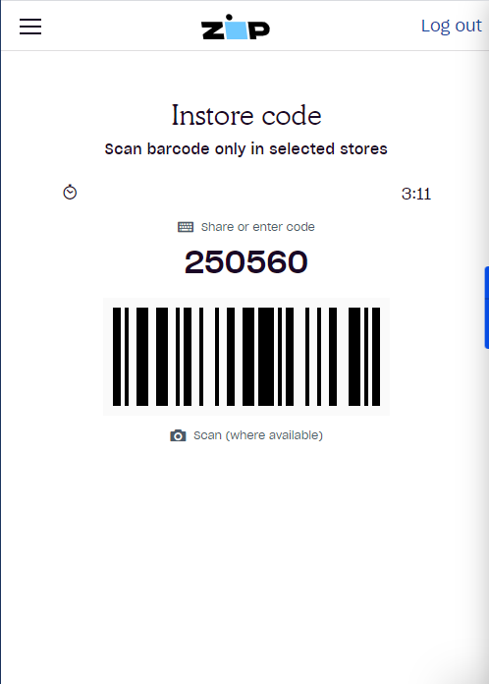
Customer Generating Code
Locating Customers’ Code
Once signed into their account via the web login or Zip Business App, a customer can generate an instore code by clicking ‘in store’.
Zip Business App
Web wallet

Slide 11
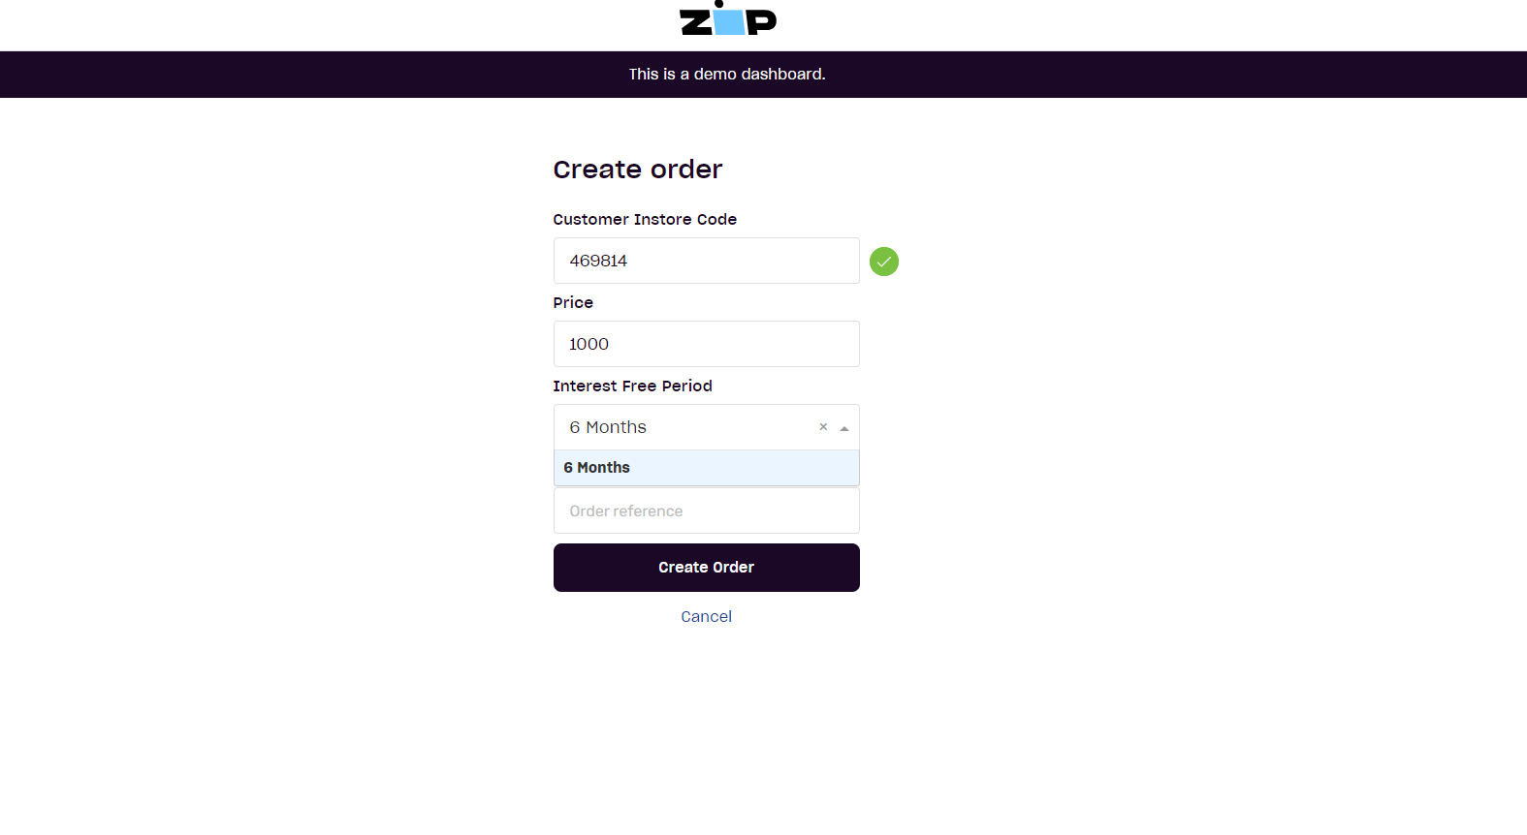
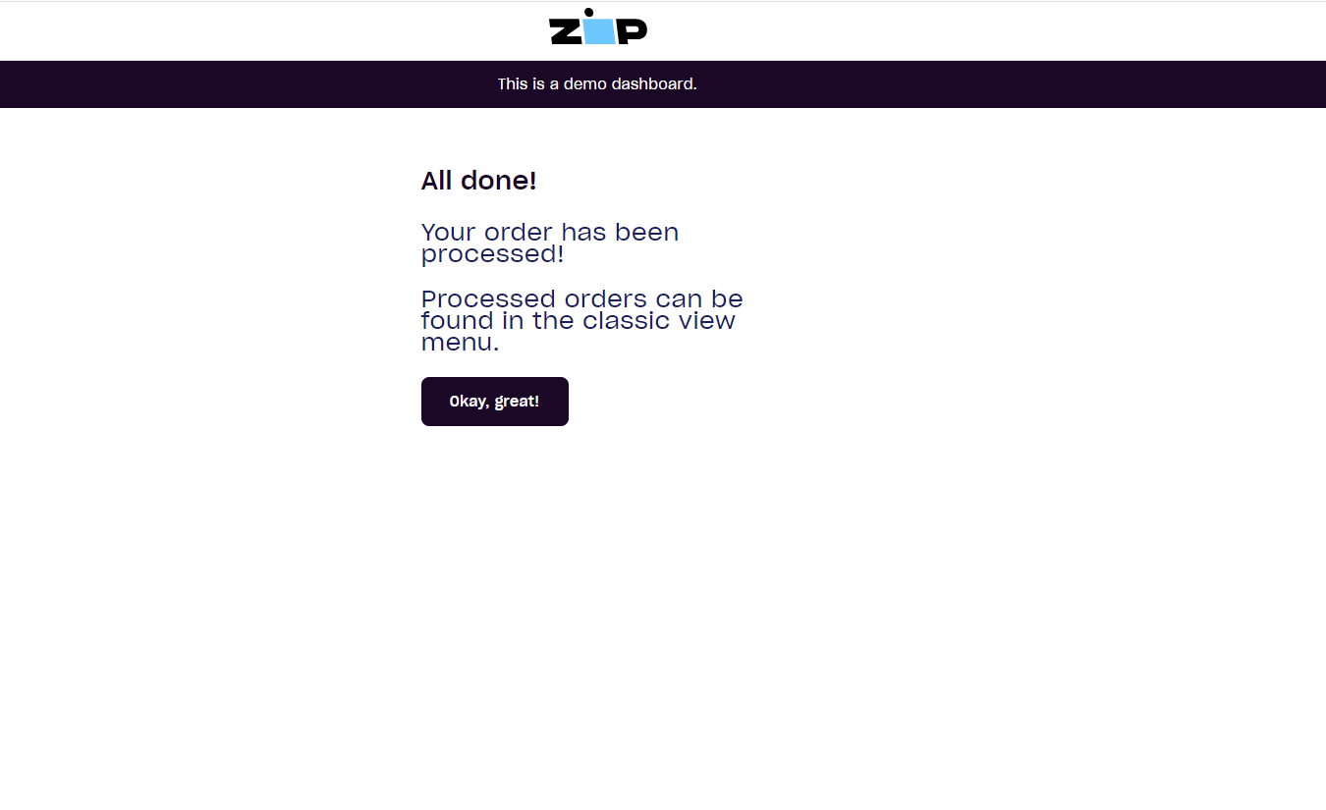
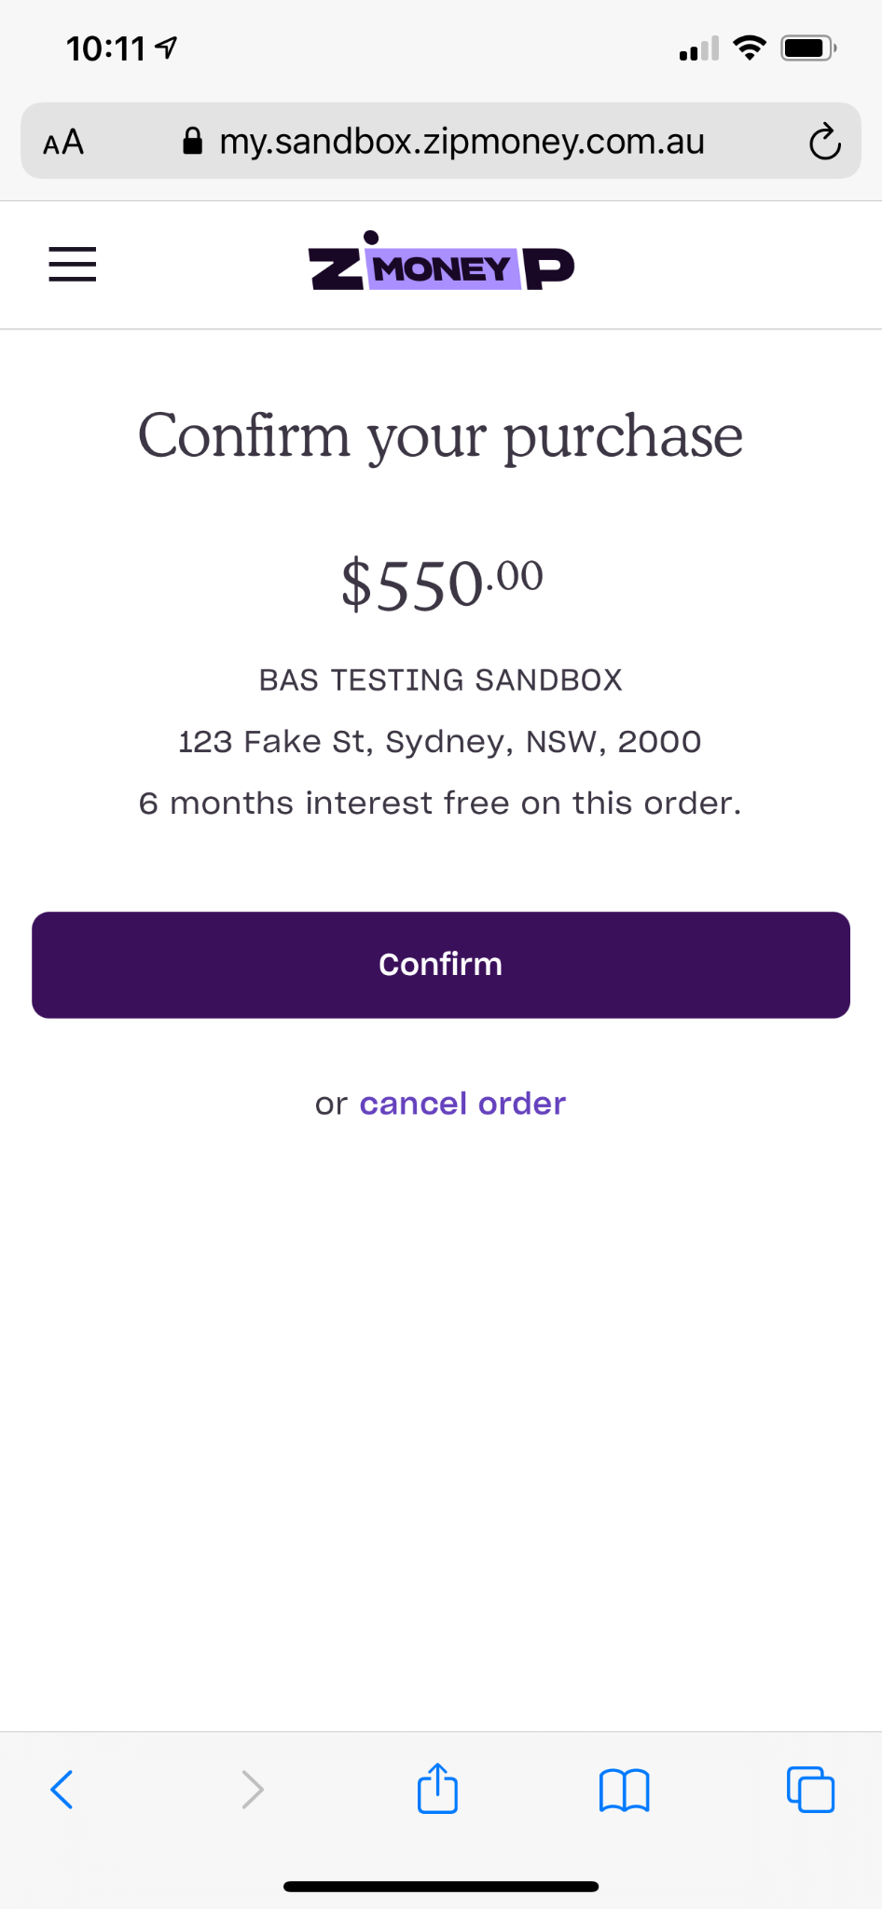
Customer’s Code
Enter the customers instore code and the price Then click ‘create Order’.
Your customer will be prompted to confirm the order on their device.
The customers instore code is a unique 6-Digit code valid for 5 minutes that the customer provides at the time of transaction.
Confirm

Slide 12
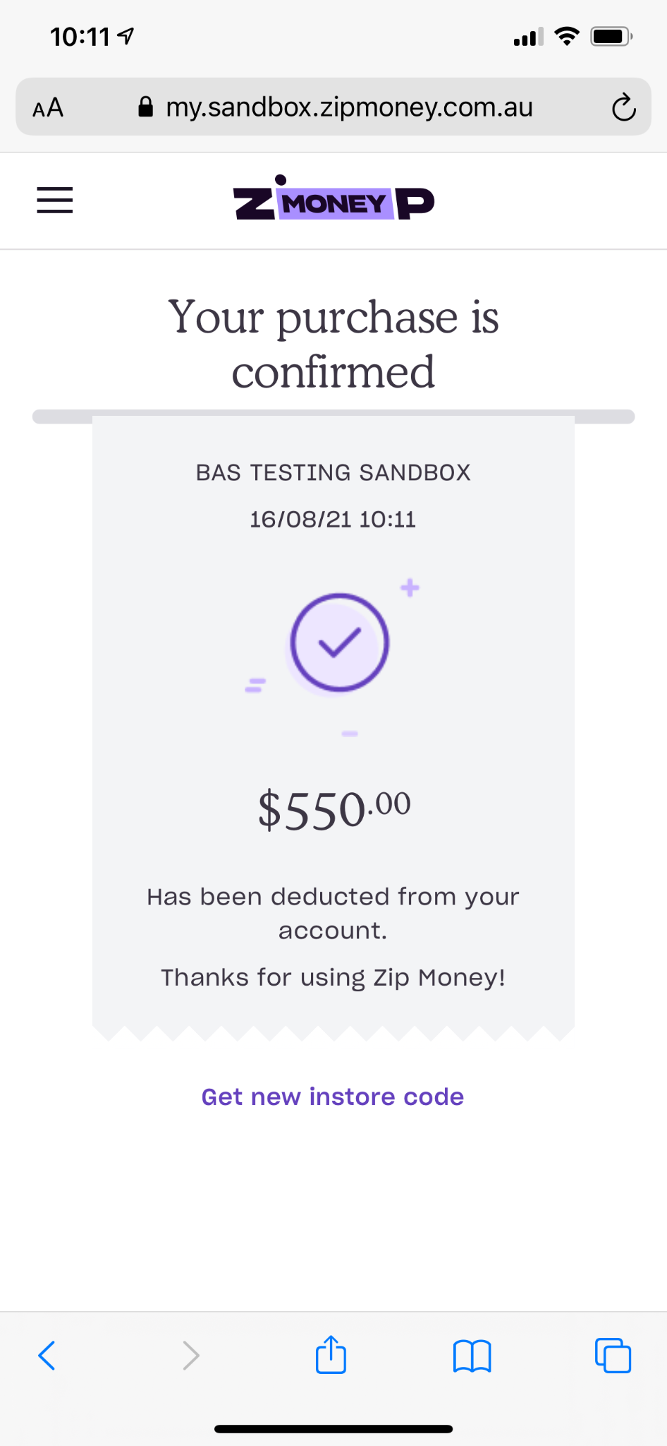
Completed Order
Once the customer has confirmed the order, it is complete!
You can view completed orders by clicking the Order Search tile on the home screen.

Slide 13
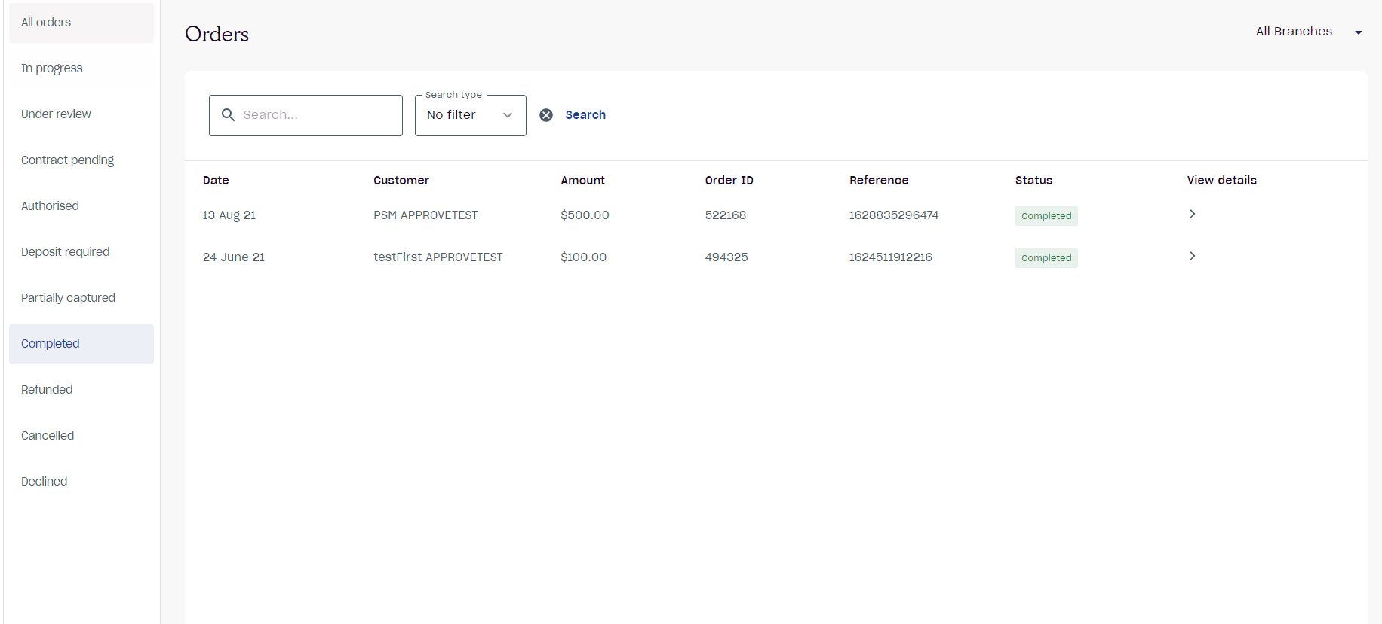
Completed Orders
Once the full amount has been captured the order status will update to Completed.
To view Completed orders, select the Order Search tile and find the order.
To view the order, click on the order and a drop down will appear with the order details.

Slide 14
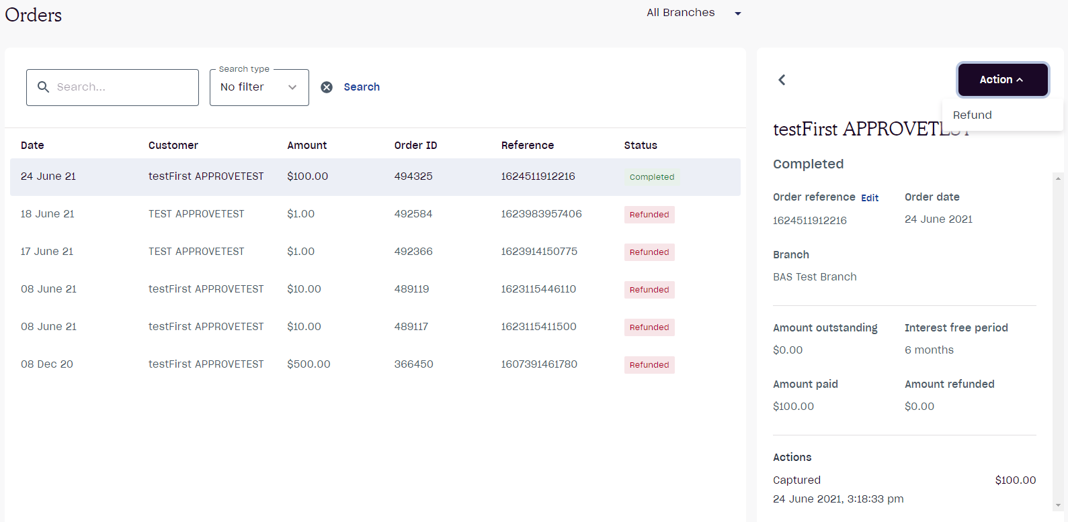
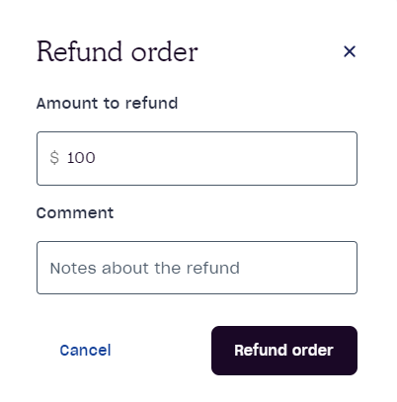
Refunding an Order
If the customer is eligible for a refund, select the Refund tile from the home page.
1.
Locate the order and click the order, in the sidebar click Action.
2.
Click Refund.
3.
If a partial refund is required edit the amount that is to be partially refunded. If the order is being refunded in full enter the full order amount.
4.
Confirm the refunded amount is correct and click Refund Order.
*Once the refund has been processed. the funds will appear instantly in the Customer’s Zip account.

Slide 15
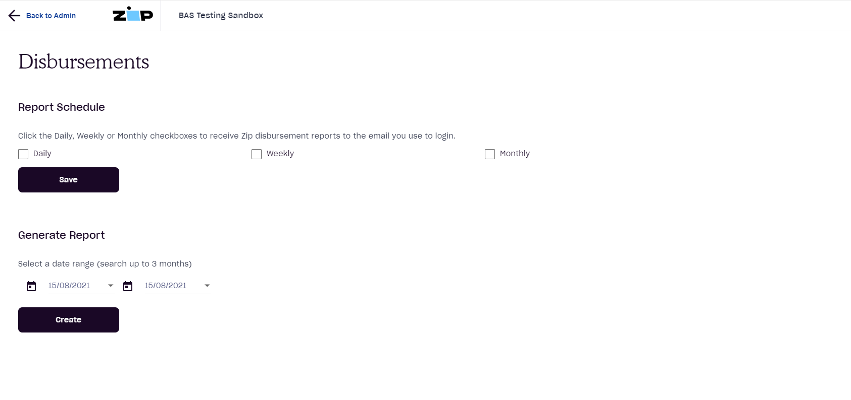
Reporting
To download a disbursement report, select the admin tile from the home page.
1.
Click Reports.
2.
Opt in to either:
Have the reports sent to you daily, weekly or monthly OR
Alternatively you can generate a manual report by selecting the required dates. Manual Reports can generated at any time for up to 3 months.
If you require a report over 3 months old, please reach out to the Merchant Support team.

Slide 16
Customer Journey

Slide 17
Customer Eligibility
An active ABN or ACN
To be eligible to apply for a Zip Business account, an applicant needs to:
in business 6+ months
More than $5,000 in monthly sales

Slide 18
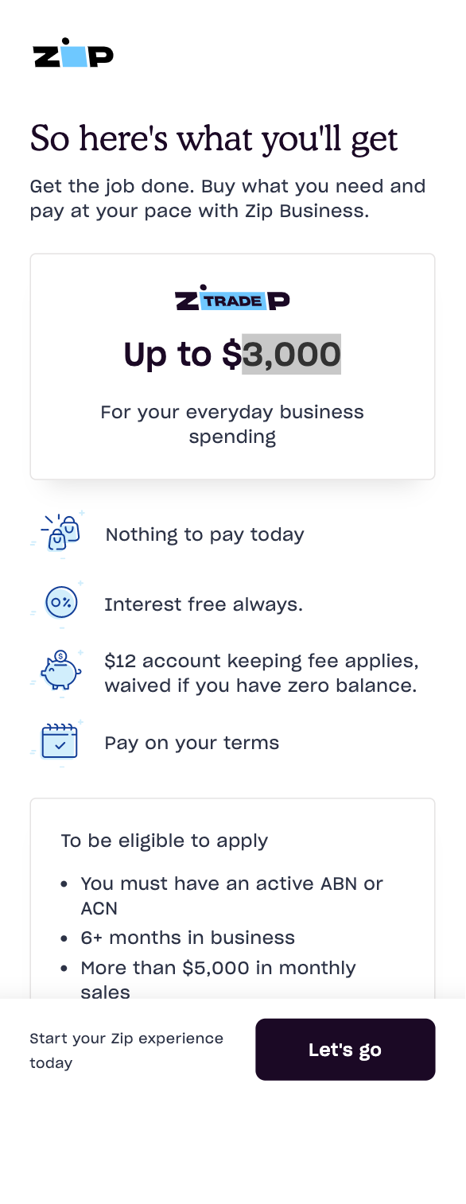
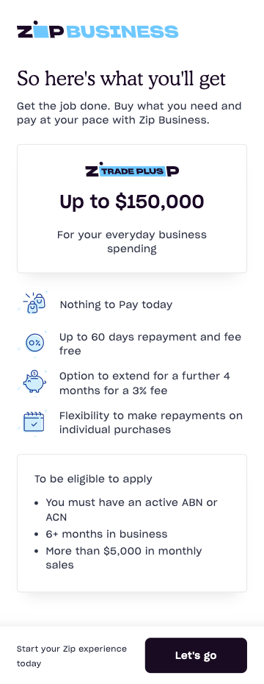
Application Process
Easy 7 steps process
Takes only few minutes to complete
Customers can apply via zip.co/business/trade
1. Verify Mobile
2. Select Product Trade or Trade Plus
3. Create an account
4. Business Details

Slide 19
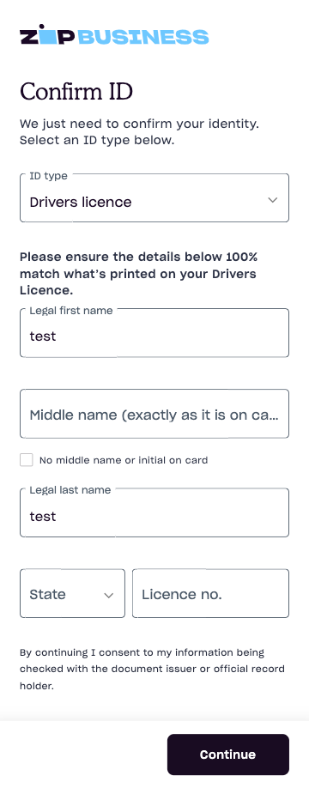
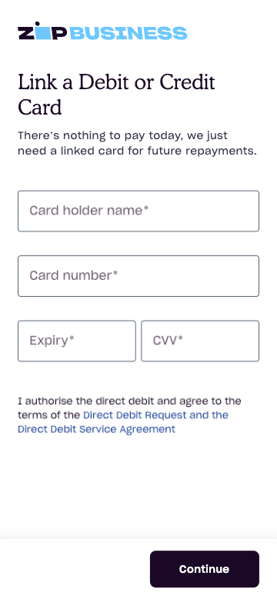
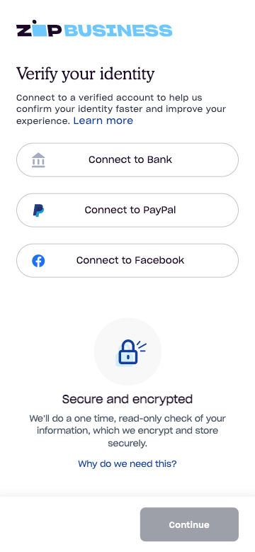
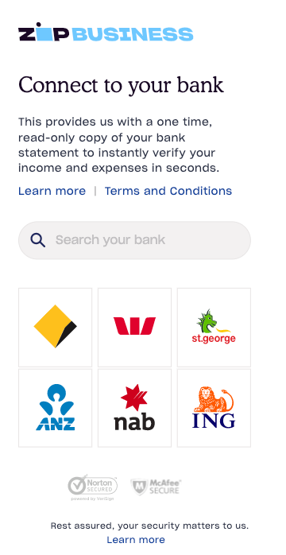
Application Process
Select preferred
Bank connection only
5. Verify identity
6. Confirm ID
7. Link Debit or Credit Card
Approved & Sign!

Slide 20
Customer Objections
Visa principal issuer
Objection
Suggested Response
Why can't I just get your terms?/I already have accounts?
Zip provides limit up to $150,000 and term up to 60 days with option to extend further so you don’t need stress about cash flow in running projects. Its once off set up and then available to reuse.
I am not comfortable to link my bank data!
Zip does not see or store your credentials and receive 'read-only' summary information regarding your recent transactions, which help to set the account limit. This process is now used by ANZ, PayPal, HSBC and many others large financial company. And Being a publicly listed company, Zip is highly complied with privacy law.
I am not comfortable getting credit from another company!
We partnered with Zip to provide more flexible options for our customers to support in a very challenging time like now. Zip is a ASX listed global company and has over 3 million customers in Australia providing more flexible payment solution.
Sellers and advertisers
I already have Zip Pay / Zip Money
Zip Pay / Zip Money are consumer account with much lower limit. Zip Trade plus is a business account with higher limit. You can have both and keep business matters separate for potential tax time benefits (subject to confirmation with your accountant)
C2C retail
Native sign-up
Seamless integrations
Customers
Targeted product feeds
Customer engagements
Increased
purchasing power
Seller/
advertiser finance
Engaged customers
Notes:
We need to cross reference which slides speaks to each of these 3, easy to follow Where do we show pay in 4 with widgets and product detail page buy on page or referral Where do we show pay in n as well

Slide 21
Merchant & Customer Support
Merchant Support
P: 02 8294 2345 (Option 2)
E: hello@partners.zip.co
Mon - Sun: 9am - 6pm AEDT
Thur: 9am - 8pm AEDT
Customer Support
P: 02 8294 2345 (Option 3)
E: trade@care.zip.co
Mon - Fri: 8am - 6pm AEDT
Sat: 9am - 6pm AEDT
Sun: Email Support
Training Resources
If you require any extra resources, visit our resources portal where you can find videos on the all the material covered today.
https://developers.zip.co/docs/the-zip-dashboard

